Slide 1
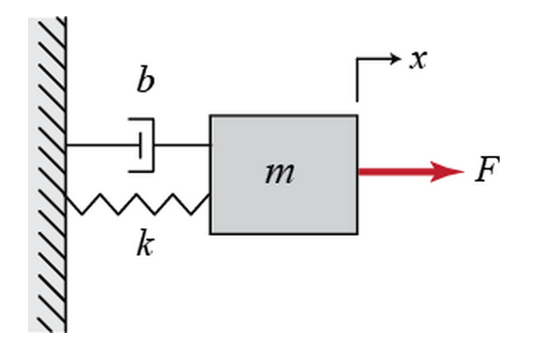
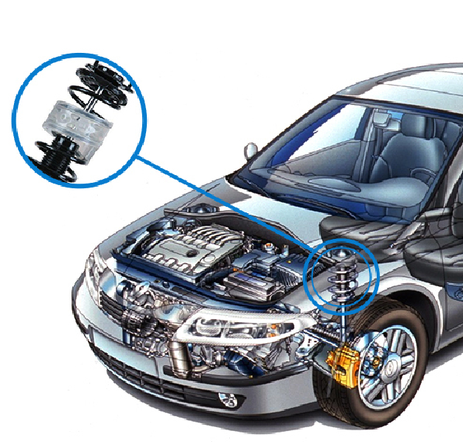
INTRODUCTION TO SYSTEM MODELING: PRACTICAL EXAMPLE
1. LET’S UNDERSTAND THE SYSTEM FIRST
SPRING & DAMPER
NO DAMPER
http://www.maplesoft.com/applications/view.aspx?SID=3926&view=html

Slide 2
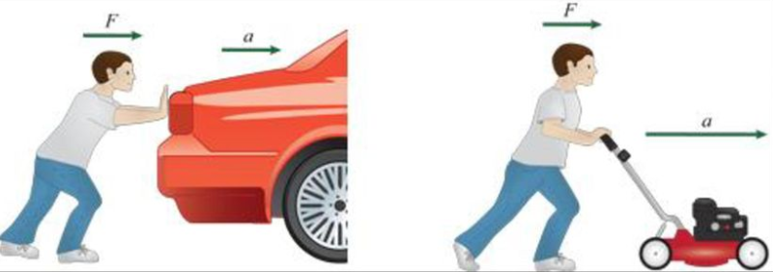

INTRODUCTION TO SYSTEM MODELING: NEWTON SECOND LAW OF MOTION
Apply the same force on two different masses, acceleration will be different!
Object with smaller mass will accelerate more
Acceleration = Force/Mass
Force = Mass * acceleration
$$\sum{F}=M∗\ddot{x}$$
http://slideplayer.com/slide/12446583/

Slide 3

INTRODUCTION TO CONTROL SYSTEMS: DEVELOP A MATHEMATICAL MODEL
$M\ddot{x}=F−b\dot{x}−kx$
$\ddot{x}=1/M(F−b\dot{x}−kx)$
http://ctms.engin.umich.edu/CTMS/index.php?example=Introduction&section=ControlPID

